Slide 1
ECE554 Microarchitecture Review
Group 2: Sega Master System
Luk, Clement
Chen, Tsung-Hao
Chen, Yi-Ting
Lin, Tsung-Chi
Luu, Dan
Jackouski, Eric
Kim, Ilhyun
Ramachandran, Karthik
Wiktor, Mike

Slide 2
Outline
System I/O and Memory
RISC Pipeline Processor
Z80 to RICS Translation
and Processor Memory Arbitration
Video Display Processor

Slide 3
ECE554 Microarchitecture Review
Group 2: SMS System I/O
Tsung-Hao Chen
Tsung-Chi Lin

Slide 4
System Overview
CPU: Z80 Processor.
Devices:
  Video Display Processor (VDP)
  Memory Paging Unit (MPU)
  Joypad Controller (JPC)
  Sound Chip (FM operator, optional)
All devices and memory share the same address bus (16-bit) and data bus (8-bit).
Use IORQ and MREQ to distinguish I/O or memory request.
MPU maps 16-bit Virtual address to 19-bit physical address.
A PS/2 keyboard acts as joypads, and communicate with CPU through the JPC.

Slide 5
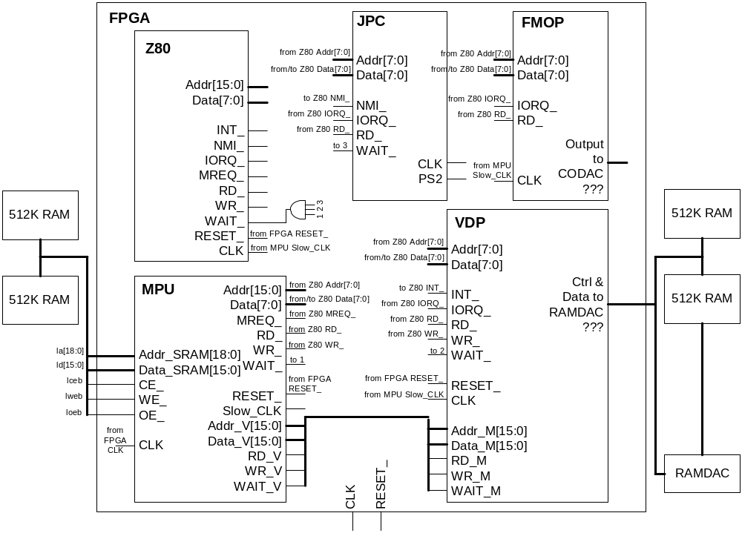
System I/O
Notes:
Devices introduction
Memory Configuration and Double clocking.
2 sets of buses, CPU<->MPU and VDP<->MPU
Interrupt INT and NMI
WAIT signal

Slide 6
Memory Paging Scheme
Reason for memory paging
  Only 16-bit Address supported by Z80
  Need to handle up to 256KB ROM + 16 KB RAM ( need 19 bits )
    Some game has 512KB ROM
Memory paging summary
  ROM Frame 0, 1, 2 ( each 16KB of size )
  On-board User RAM ( 8KB X 2 )
  Frame Control Registers (FCR’s)
    $FFFC : RAM select register
    $FFFD : Frame 0 ROM bank
    $FFFE : Frame 1 ROM bank
    $FFFF : Frame 2 ROM bank

Slide 7
Main Memory Map
Starting Address (hexadecimal)
Description
0x0000 ~ 0x03FF
First 1 kilobyte of ROM page 0
0x0400 ~ 0x3FFF
Frame 0, (Last 15 kilobytes, first kilobyte is always from page 0)
0x4000 ~ 0x7FFF
Frame 1
0x8000 ~ 0xBFFF
Frame 2
0xC000 ~ 0xDFFF
Program RAM
0xE000 ~ 0xFFFB
Mirror of Program RAM (Except last four bytes)
0xFFFC
Control byte for Frame 2 (described below)
0xFFFD
Page to go into Frame 0. (Only last 15 kilobytes of selected page. The first kilobyte is always from ROM page 0.)
0xFFFE
Page to go into Frame 1
0xFFFF
Page to go into Frame 2

Slide 8
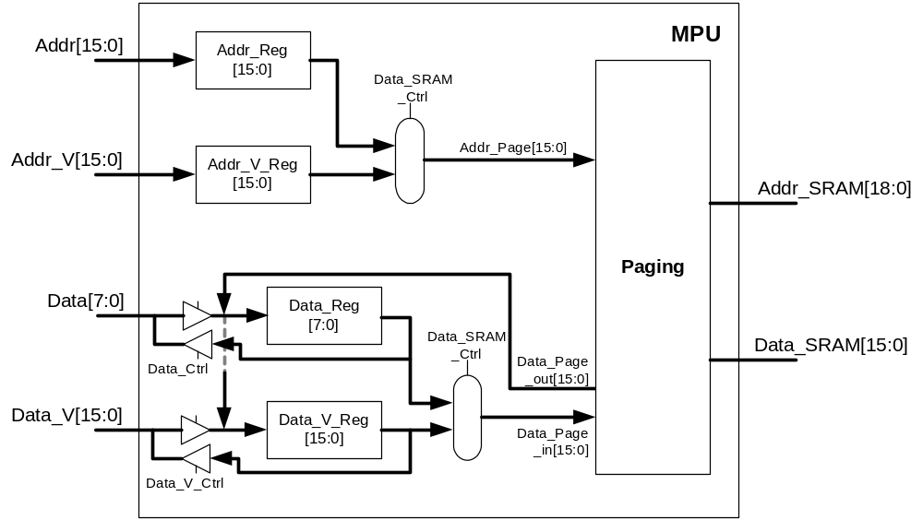
MPU (Memory Paging Unit)

Slide 9
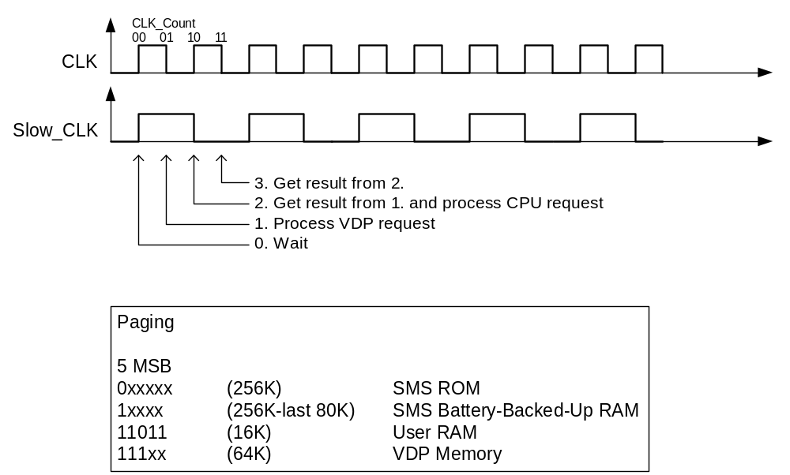
MPU Timing and Memory Mapping

Slide 10
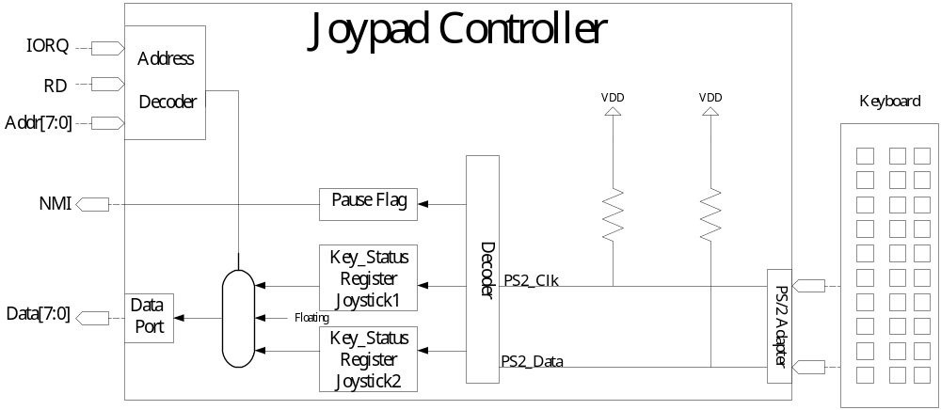
Joypad Controller (JPC Unit)

Slide 11
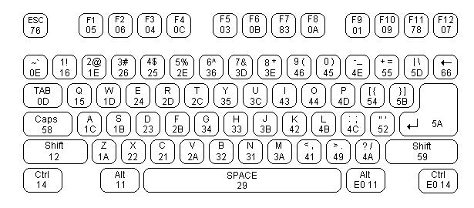
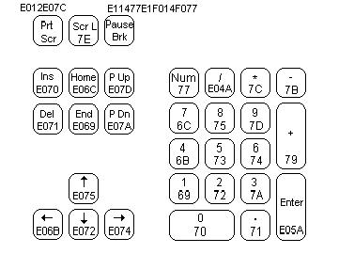
Joypad to Keyboard Mapping
 |  | Up | Down | Left | Right | FireA | FireB
Joy1 | Mapping Key | Ｗ | Ｓ | Ａ | Ｄ | < , | > .
 | Scan Code | 1D | 1B | 1C | 23 | 41 | 49
Joy2 | Mapping Key | ↑ | ↓ | ← | → | 0 Ins | . Del
 | Scan Code | E075 | E072 | E068 | E074 | 70 | 71

